Slide 1



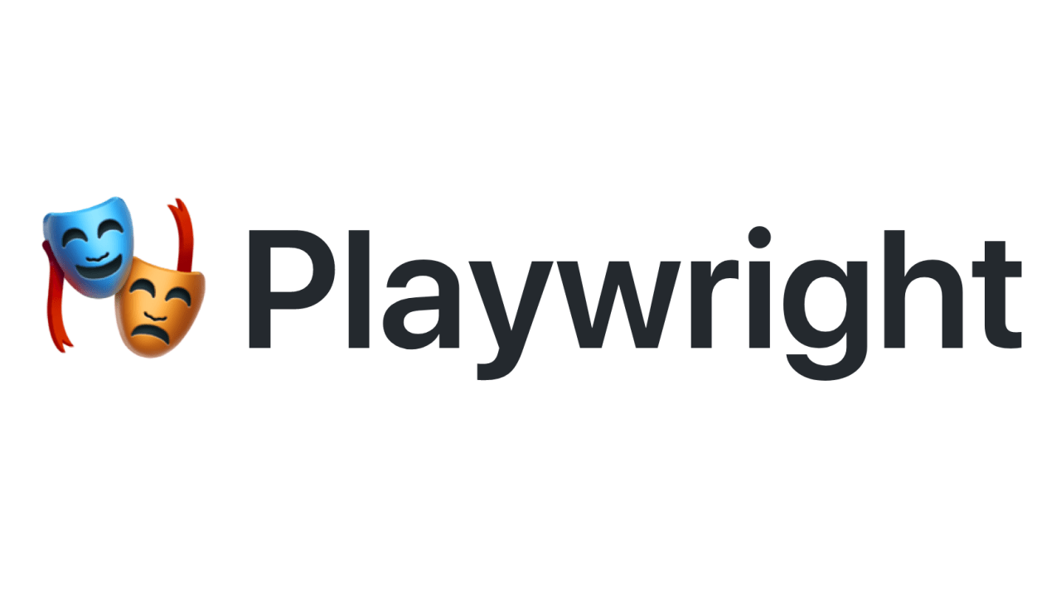
Learning PlayWright (Java)
E2E Web Testing with Playwright(Java)
Pramod Dutta
SDET Manager
Playwright Selectors(Java) - Part 3

Slide 2
Agenda
Playwright Selectors
Click, Navigate and many more…
Lets Automate a Test cases #2
Sign up form of vwo.com
https://app.vwo.com/free-trail/

Slide 3
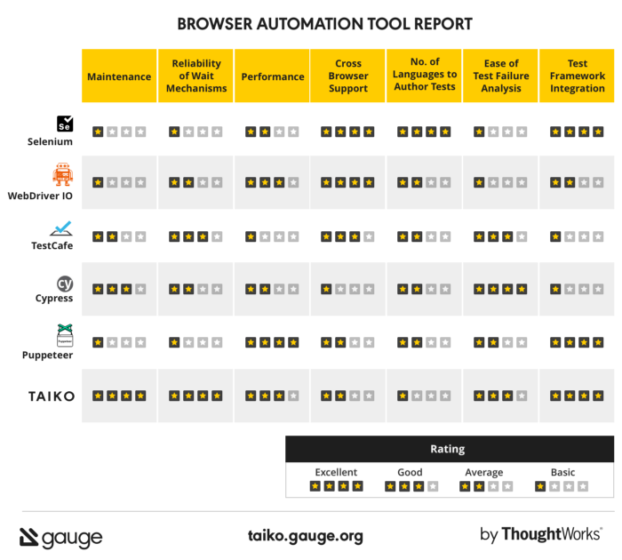
Playwright Selectors

Slide 4
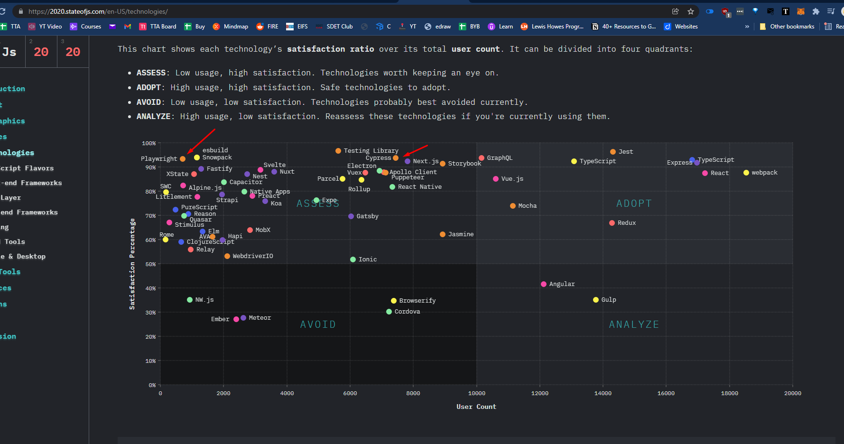
Playwright Popularity
https://2020.stateofjs.com/en-US/technologies/

Slide 5
Playwright Selectors
Text selector
page.locator("text=Log in").click();
https://playwright.dev/java/docs/selectors#text-selector
CSS selector​
page.locator("button").click();
https://playwright.dev/java/docs/selectors#css-selector
Shadow DOM
Css and text engines pierce the Shadow DOM by default:
https://playwright.dev/java/docs/selectors#selecting-elements-in-shadow-dom
​

Slide 6
Playwright More
click()
fill()
Full page screenshots​
https://playwright.dev/java/docs/screenshots
Element screenshot​
https://playwright.dev/java/docs/screenshots#element-screenshot

Slide 7
Playwright Demo.

